Slide 1
Servus
1
Python Intermediate – Spring 2025 Topic: Inheritance and Polymorphism

Slide 2
Ask, ask, ask!
If:
you have a Python related problem...
something is not working…
you don’t understand an exercise...
you need help somehow...
Then:
write your question in our Slack channel, maybe someone else had the same issue and can help you
write a colleague on Slack
write a teacher on Slack
note it down and ask next class
...just don’t let it block you!

Slide 3
OOP - review

Slide 4
Inheritance

Slide 5
Inheritance
Inheritance is a fundamental concept in object-oriented programming (OOP). It allows you to create a new class (called a child class) based on an existing class (the parent class). The child class inherits attributes and methods from the parent class.
Child classes can reuse code from the parent class, promoting code reuse and reducing duplication.
You can add new attributes and methods to the child class.
If a method in the child class has the same name as a method in the parent class, it overrides the parent’s method. This is known as method overriding.

Slide 6
Inheritance
Animal
Dog
Cat

Slide 7
Inheritance
class Animal:
def __init__(self, name): self.name = name
def speak(self):
return “”
class Dog(Animal):
def speak(self):
return “Woof, woof”
class Cat(Animal):
def speak(self):
return “Miau”

Slide 8
pass
Pass can be used if the function doesn’t do anything

Slide 9
Inheritance
Parent class is the class being inherited from, also called base class. The parent class can also be called as the function super() when calling from the derived class
Child class is the class that inherits from another class, also called derived class or subclass.
Method Overriding is redefining the definitions of methods in child class which was already defined in parent class.

Slide 10
# File – animal.py
# Parent class
class Animal:
def __init__(self, name):
self.name = name
def speak(self):
return ""
# Child class - Dog inherits from Animal
class Dog(Animal):
def speak(self):
return "Woof! Woof!"
# Child class - Cat inherits from Animal
class Cat(Animal):
def speak(self):
return "Miau"
# Creating objects
dog = Dog("Buddy")
cat = Cat("Whiskers")
print(dog.name, "says:", dog.speak())
print(cat.name, "says:", cat.speak())

Slide 11
__init()__

Slide 12
# Check also the file – animal_constructor.py
# Parent class
class Animal:
def __init__(self, name):
self.name = name
def speak(self):
return ""
# Child class - Dog inherits from Animal
class Dog(Animal):
def speak(self):
return "Woof! Woof!"
# Creating objects
dog = Dog("Buddy")
__init()__
Init is the constructor and is automatically called every time a class's object gets created
Constructor called

Slide 13
super()

Slide 14
# Check also the file – animal_constructor.py
# Parent class
class Animal:
def __init__(self, name):
self.name = name
# Child class for Cat
class Cat(Animal):
def __init__(self, name, lives_left):
super().__init__(name)
self.lives_left = lives_left
# Child class for Dog
class Dog(Animal):
def __init__(self, name, chew_toys_chewed):
super().__init__(name)
self.chew_toys_chewed = chew_toys_chewed
# Creating objects
dog = Dog("Buddy", chew_toys_chewed = 3)
cat = Cat("Whiskers", lives_left = 9)
super()
super() is used to access the parent function – for example, if you want to call the constructor of the parent function from the constructor of the child function

Slide 15
Exercise – to do together

Slide 16
You’re working on a veterinary which wants to manage important information about the animals it treats!
Write a class Animal which saves the name and age of the animal
Specify a Dog subclass and a Cat subclass (the dogs require the information of how many toys they chewed in a lifetime, and the cats how many lives they have left)
Create a __str__() function for both dogs and cats
Create a list with different animals
Print all the animals in the list
Exercises

Slide 17
Exercise – to try alone
Call the teachers for questions!!

Slide 18
Write a class named Employee which contains a person’s first name, last name, and employee ID. You can pass this information through the constructor.
Write a class named SalariedEmployee that inherits from Employee. This class has a new attribute to store the employee’s yearly salary rate. Pass it either through the constructor or a property method.
Write a class named HourlyEmployee that inherits from Employee. This class has two new attributes, their hourly pay rate and the number of hours they worked this month. Pass these through the constructor.
In your main function, create two different objects, one of SalariedEmployee and another of HourlyEmployee.
Inheritance

Slide 19
Update the Employee class to include a new method called calculate_pay(). In this method, just print the value of 0.
Update the SalariedEmployee class to include a new method called calculate_pay(). In this method, print out the monthly salary rate for the employee (1/12 of the yearly rate).
Update the HourlyEmployee class to include a new method called calculate_pay(). In this method, calculate the monthly pay and print it out (hourly rate * number of hours worked this month).
Write a function (outside of any class) calculate_employee_pay which takes an Employee object as its parameter and in the function call calculate_pay() on that object.
Call the function two times, once with a SalariedEmployee object, and once with an HourlyEmployee object.
Inheritance

Slide 20
Bonus – if we have time, or do it at home!!!
Vet manager:
instead of creating a list, use a loop asking for user input to input the dog/cat
Employee:
How can the calculate_employee_pay() function check if the object being passed to it is of type Employee (and therefore has the calculate_pay() function?) – check the .py for the solution
Inheritance

Slide 21
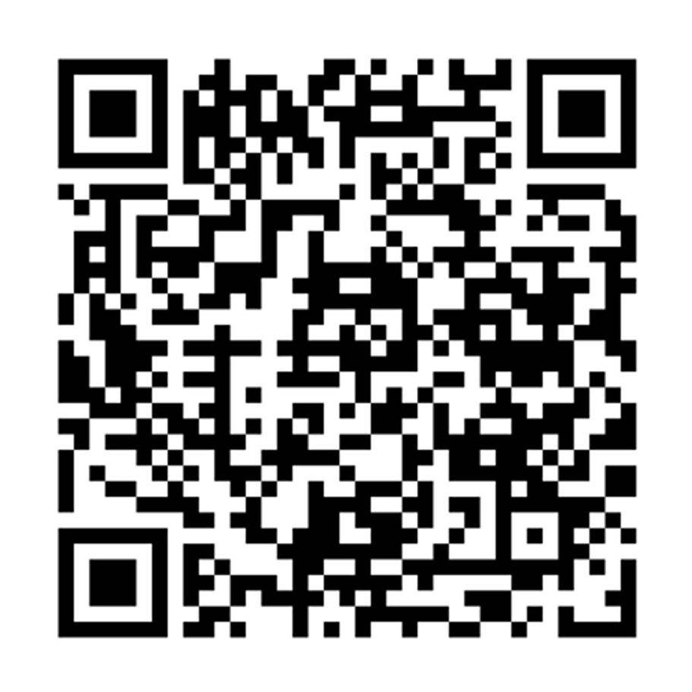
Before you go…
Scan the QR code or go to:
https://redischool.typeform.com/lessonfeedback

Slide 22
22
Thank you for your attention!

